Slide 1


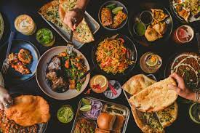
ONLINE FOOD
MANAGEMENT SYSTEM
GRAPHIC ERA HILL UNIVERSITY BHIMTAL
B.TECH III Semester, 2022
Prepared by:
Pooja Joshi
Mahak Saxena
Sangeeta Chawla

Slide 2
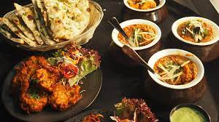
About
Food Order Management System is based on the concept of ordering food and managing employer records. Admin section and customer section. Admin section, from where the user can manage employee and customer section, from where a user can order food. This mini project contains limits features, but the essential one. To run the project use code editor for C programming language.
There is one more section about the developer of this project.

Slide 3
Function used in the project
mainmenu()
administration()
addrecord()
deleterecord()
searchrecord()
viewrecord()
customer()
vegetarian()
nonvegetarian()
Aboutus()

Slide 4
BENIFITS
1. More accuracy and easy order process.
2. Fast , easy and comfortable.
3. Mobile friendly.
4. 24*7 customer supports.
5. Crush your competitors.

Slide 5
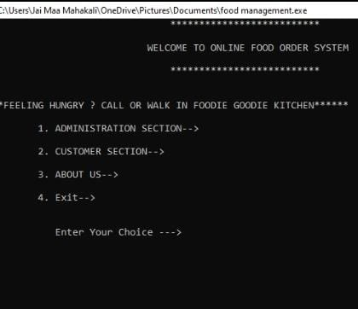
MAIN MENU
This is the main
section from where
we chose in which
Section we have top
Go.

Slide 6
.
THANK YOU

